Slide 1
Providing targeted responsible foreign aid
Group 5: Ron, Kushal, Jimin, Seunggil

Slide 2
Contents
Project Background
Talk about problems, current status, background
Data and EDA
Data
Data collection, what type of data, data timeframe, countries focused
EDA
Foreign aid trends, GDP trends (line charts)
Methodology
Model Building
Final results
Final Charts/dashboard/word clouds/topic modeling
Conclusion/Future Work

Slide 3
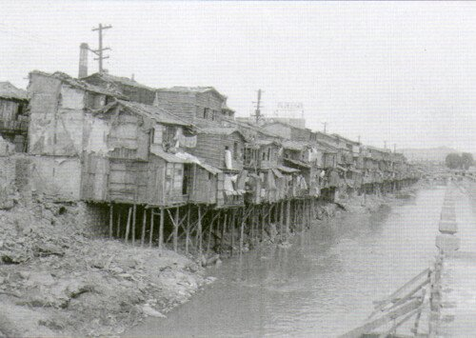
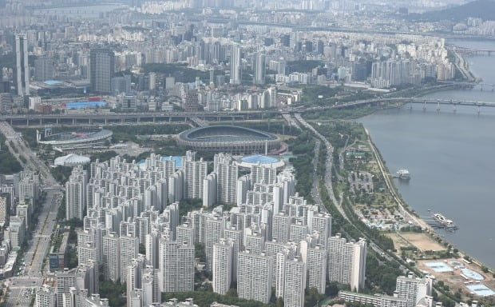

Why Foreign Aid?
Example of South Korea
→ Now, Korea became Strong Alliance of USA
→ Korea is Contributing to the advancement of the world

Slide 4
Skepticism about Foreign Aid
In 2020, US government had spent $51.05 billion US dollars in foreign aid
But, many mixed perspectives about effects of foreign aid exist
Many countries still remain as Least Developed Countries(LDC):
→ hasn’t reduced poverty rate
Provide Targeted, Responsible Foreign Aid !
→ Aid that has actual outcome
<Question>
<Solution>

Slide 5
Focusing on TARGETED, RESPONSIBLE
Targeted: For which country does aid be helpful?
→ for which country aid should be given?
Responsible: The aid should helpful for the nations
→ In which way the recipient nation get beneficial results?

Slide 6
Various types of Foreign Aid
there are various kinds of foreign aid exist
Disbursements(fund)
obligations
Bilateral Aid
Military Aid
Multilateral Aid
Humanitarian Assistance
…
Our Solution focuses on Economic type of Aid
→which might influences GDP per capita

Slide 7
Overview of our solution
Economic Indicators
Regression
(predicting)
Corruption Perceptions
Index
K-Clustering
(filtering)
Combine all the results
predict expected GDP per capita out of Proper Aid
Dashboard
for US embassy
Foreign Aid Description text data
Word Cloud
(supplementary)
Inputs
Model
output

Slide 8
datasets - source
World Bank Data
OECD data
Corruption Perception index
Text Analysis
Our Total Dataset :
World Development Indicators across countries

Slide 9
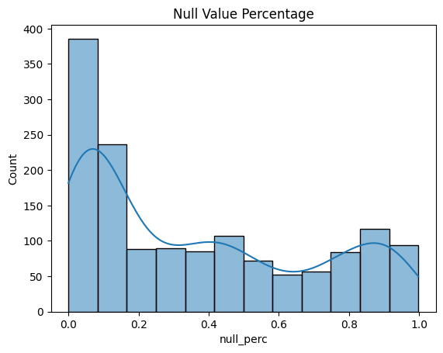
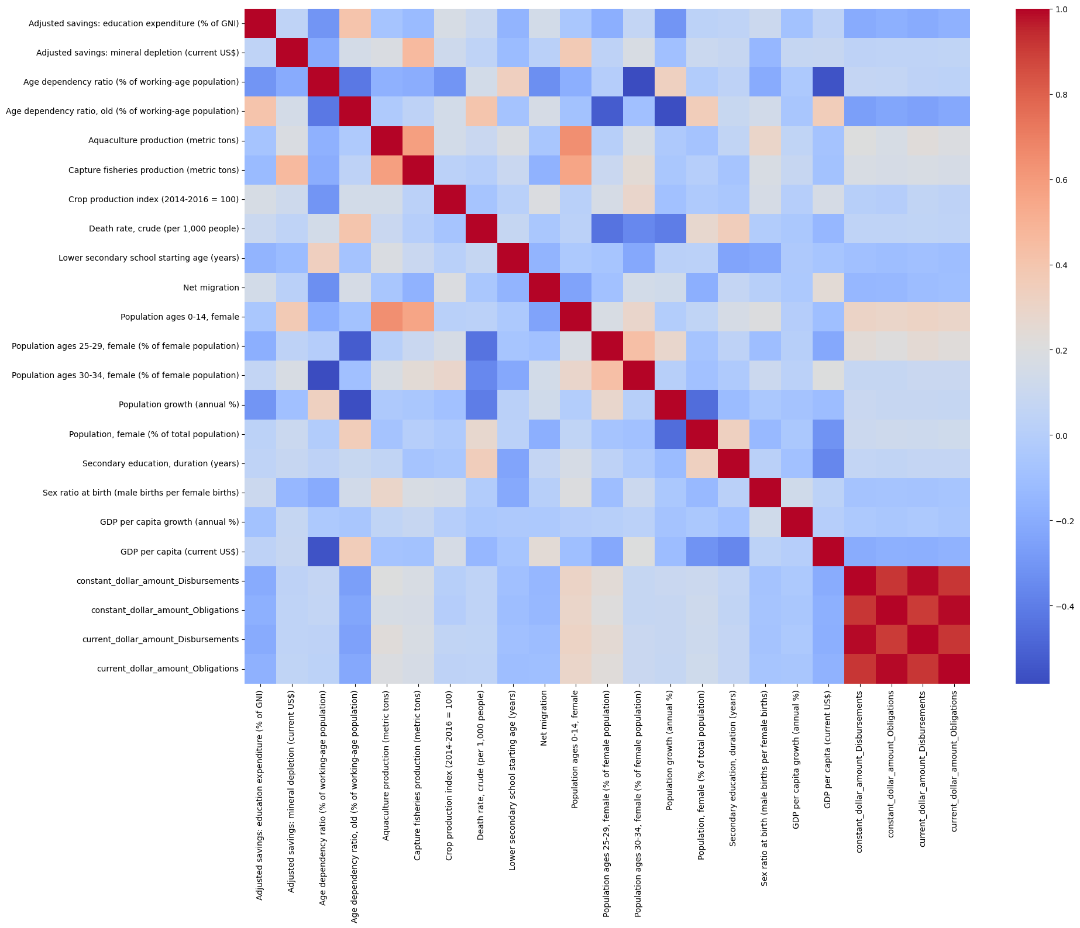
Countries & Indicators
Total Countries(34)
Latin America(24) + Southeast Asia(10)
Indicators (+ foreign aid)
1478 -> 21
Percentage of null values of feature across all countries
Correlation of selected features
Notes:
availability of featurs

Slide 10
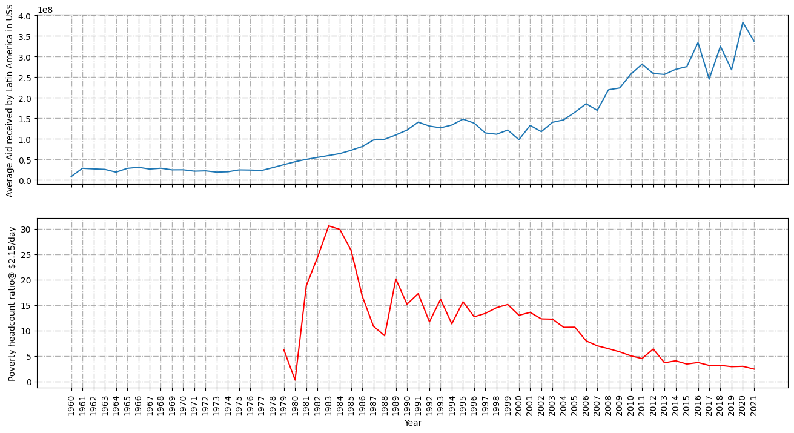
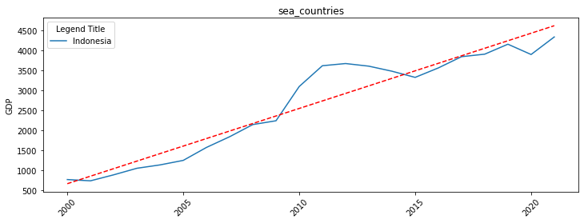
Trends & Correlation of Foreign Aid + GDP
In Latin America and South East Asia countries,
As average aid increases, GDP is also increased.
There is Correlation between GDP and Foreign Aid

Slide 11
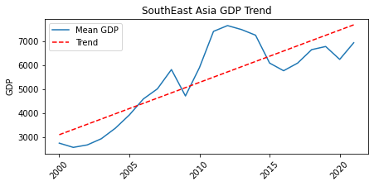
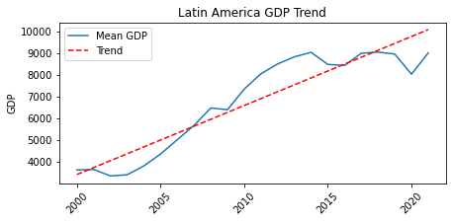
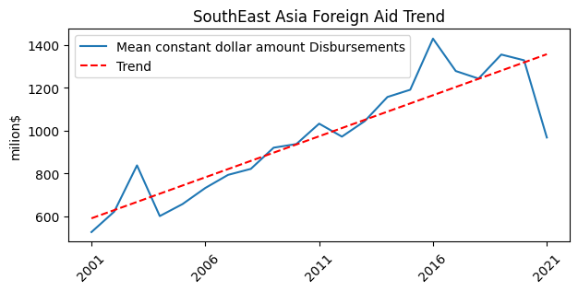
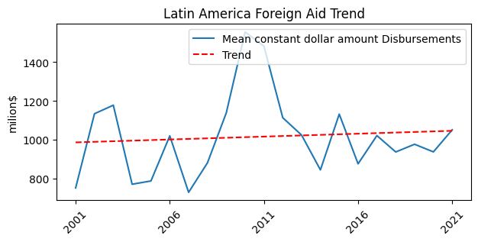
Current status of Foreign Aid and GDP
currently only historical data is considered for budgeting next year
Possible solution : predictive modeling for budgeting next year

Slide 12
Modelling
Regression model for predicting:
Target outcome
GDP per capita (current US $)
Explanatory variables
Adjusted savings education expenditure of GNI
Adjusted savings mineral depletion current US
Age dependency ratio of working age population
Age dependency ratio old of working age population
Aquaculture production metric tons
Capture fisheries production metric tons
Death rate crude per 1000 people
Lower secondary school starting age years
Net migration
Population ages 25-29 female offe male population
Population female of total population
Secondary education duration years
Sex ratio at birth male births per female births
GDP per capita growth annual
constant_dollar_amount_Obligations
current_dollar_amount_Obligations
Foreign Aid

Slide 13
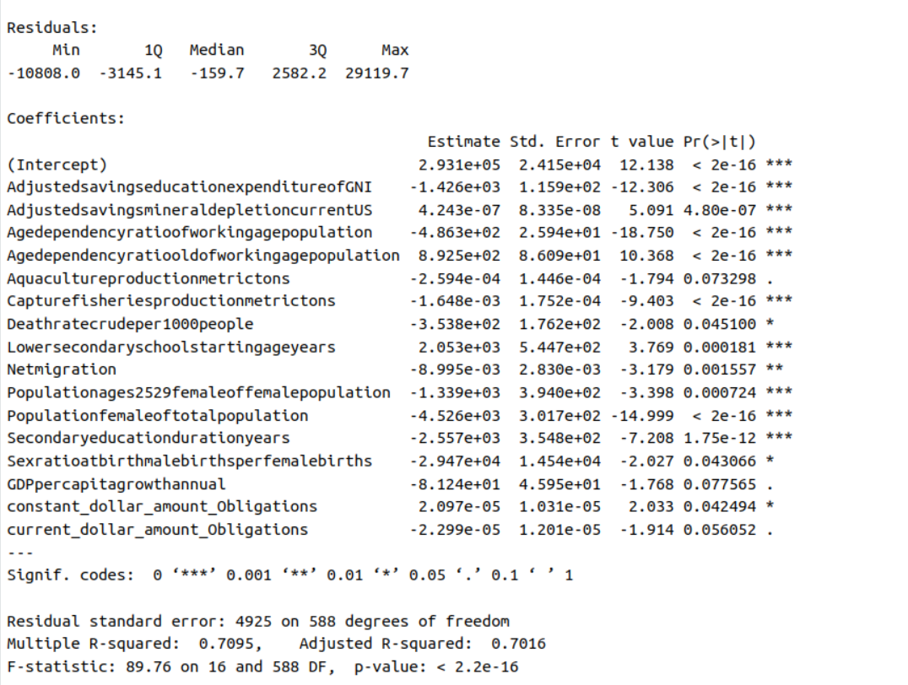
Baseline Model
To build hypothesis and assumptions about underlying dataset
Linear regression model
Results:
Most features are significant
Reported error (adj R2) = 0.70
RMSE = $ 4854.85
F-statistics p-value < 2.2e-16
Conclusion:
GDP can be modelled as a function of multiple World Indicators, including Foreign Aid
Regression results are promising yet due to high error, needs some non-linear approach

Slide 14
Advanced Models
KNN
Decision Tree
Random Forest
Non-parametric memory based model
East to understand and implement
Non-linear model
Easy to understand and implement
Better explainability
Combination of multiple decision trees
Captures non-linear relationship within features
RMSE = $ 8464.376
RMSE = $ 2404.05
RMSE = $ 1120.86
Conclusion
Error is high
Prediction will be $8464.37 off from actual
Conclusion
Error is high
Prediction off by $2404.05 from actual
Conclusion
Low error
Only off by $1120.86 from actual

Slide 15
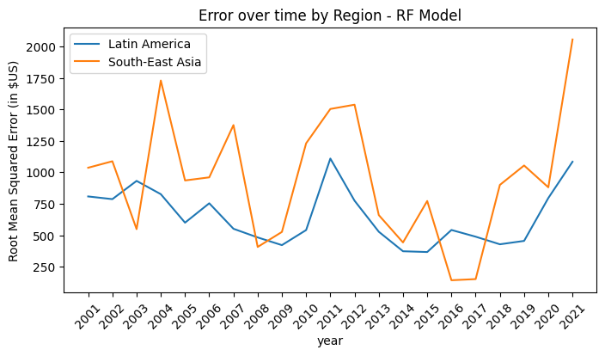
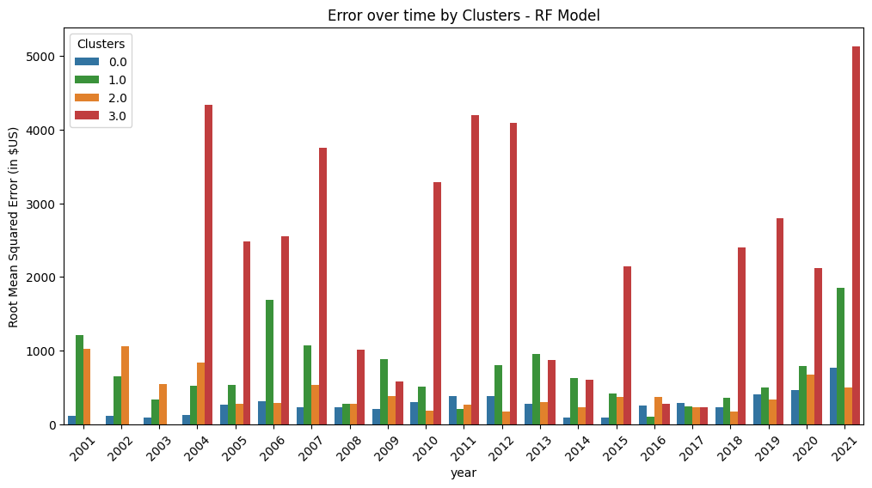
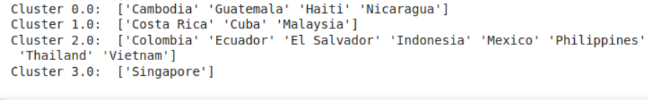
Model drawbacks
Not performing well on recent data, error peaks for latest year metrics
Cluster 2 performing very well, will be reliable for providing targeted aid
Cluster 3 (Singapore) has higher RMSE over time

Slide 16
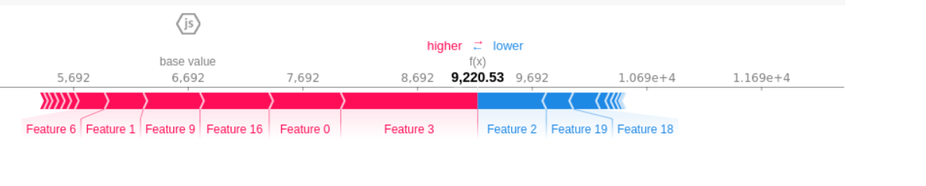
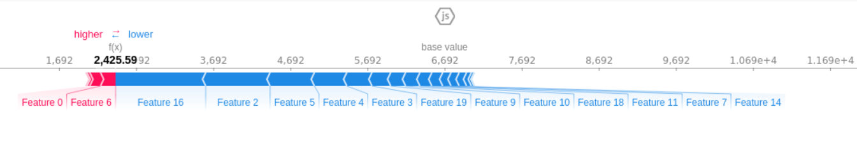
Model Interpretability
Explaining model predictions using SHAP (SHapley Additive exPlanations) Values
Two instances from dataset and how each feature is drawing the prediction towards or away from the expected value ($ 6692)

Slide 17
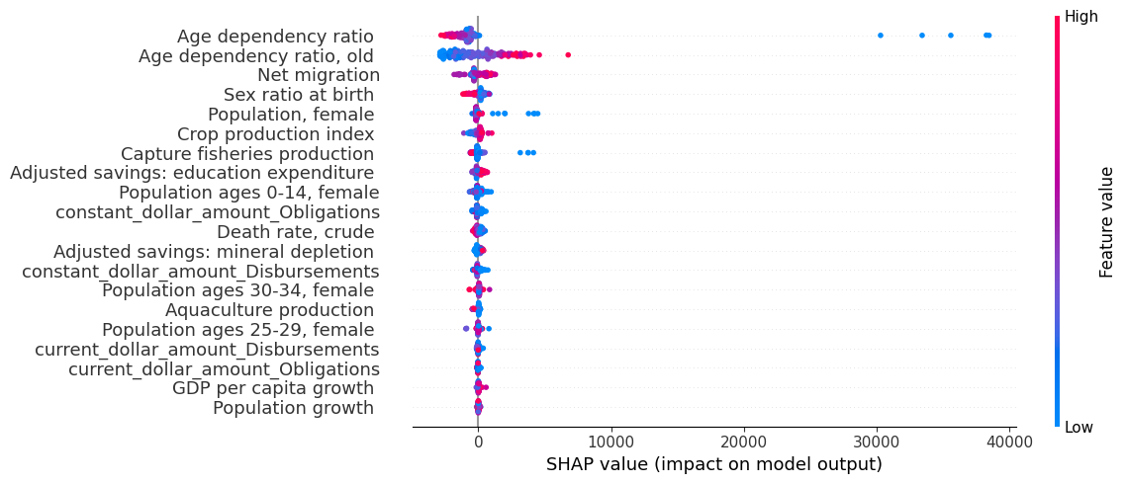
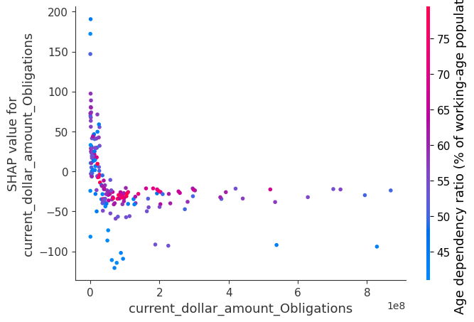
Model Interpretability - contd.
Overall high Age dependency ratio of working age population will draw model predictions away from expected value ($6692.27) - GDP will increase with high ratio of working population overall
Increase in Crop production index will have higher impact on model prediction - Agriculture production will improve the economic condition of countries

Slide 18
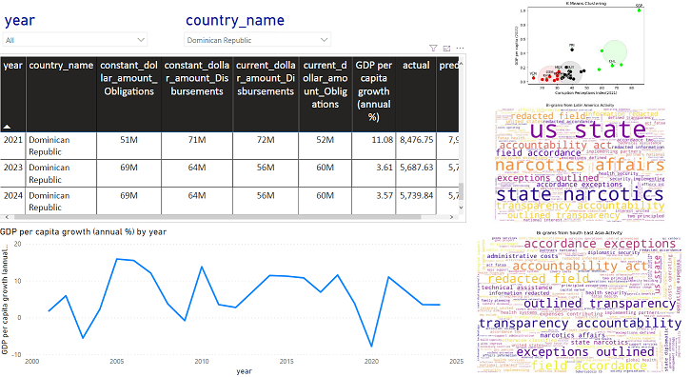
Final Results : Dashboard

Slide 19
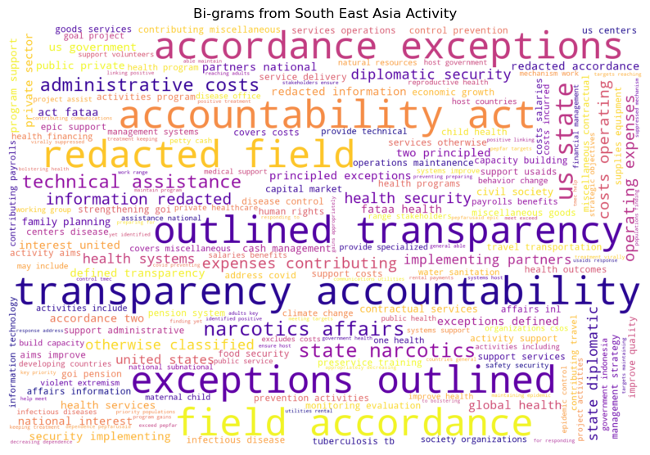
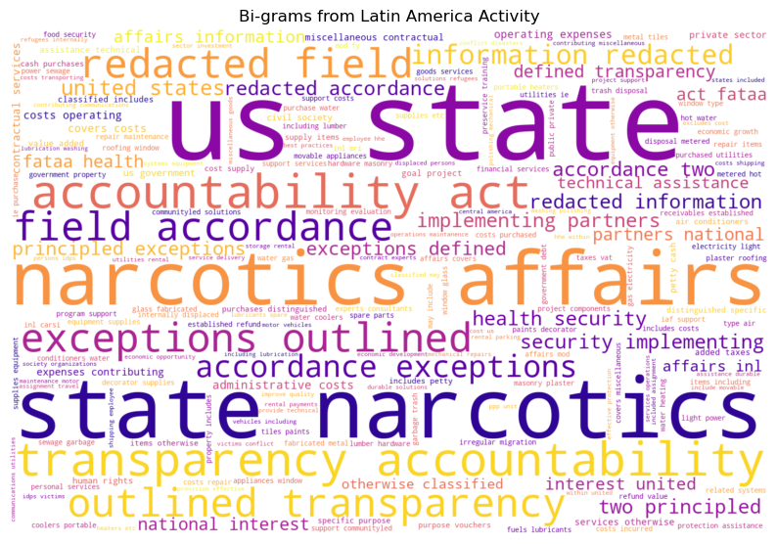
Final Results: SEA & LA

Slide 20
Topic modeling:
Clustering Activities of countries based on similarities

Slide 21
Future work.
Domain Understanding
Involvement of US Embassy for domain knowledge to better understand the process and identify areas where this solution can fit
Come up with a survey monkey questionnaire where the different users at the U.S embassy can review any model changes or suggestions.
Continuation of topic modeling:
how the U.S embassy should go about using th results
Creating policies for different countries.
Process
Improvements to the dashboard according to US Embassy requirements
Use best analytical practices to avoid discrepancies within data and modeling part

